Slide 1
PyTorch in a day
PHANI SRIKANTH - Data Scientist @ Reliance Jio
SUPREETH MANYAM - Data Scientist @ Ola

Slide 2
WHO ARE WE?
PHANI SRIKANTH (a.k.a. binga)
Machine Learning at Gigster, Data Science at Jio, Ex-Housing etc.
Electrical Engineer
AV # 4 (Best)
Occasional Medium blogger
Cricket fanatic
Fan of Live music

Slide 3
WHO ARE WE?
SUPREETH MANYAM (a.k.a. ziron)
Data Scientist @ Ola. Previously @ SocGen.
Civil Engineering from NIT-W (2015 Batch)
AV #7 (Best)

Slide 4
SCHEDULE
09:15 - 10:15 Introduction, Basics and Environment Setup
10:15 - 12:30 PyTorch Walkthrough
12:30 - 13:00 CNNs, Introduction to pretrained models and transfer learning
13:00 - 14:00 Lunch
14:00 - 17:00 DIY exercises hackathon on DataHack LB
17:00 - 17:30 Advanced usage and where to go next.
17:30 - 18:00 Q&A, AMA and General Discussion
Less talk, more interactions
Focus on end-to-end learning
Hands-on work
Personalized help and discussions

Slide 5


GOAL
Spin up a GPU enable machine
Ensure all the libraries are installed
Learn about the basic building blocks of PyTorch
Build a simple linear regression model using PyTorch
Build a CNN classifier
Do transfer learning using a pretrained network
Compete on a hackathon on AV
Feel awesome!

Slide 6
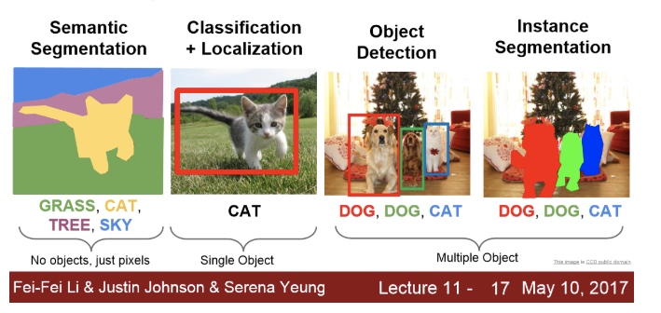
Image Processing
Availability of unstructured data - social media
Availability of advanced algorithms
Image Classification
Object Localisation
Image Segmentation
Semantic Segmentation
Pose Estimation
http://cs231n.stanford.edu/2017/syllabus.html

Slide 7
What is PyTorch?
General purpose Python based matrix library that runs on GPUs
Python Deep Learning framework
Soumith and team from Facebook AI Research
Open Source (2016)
PyTorch 0.4.1 (27th July, 2018)
NEW: PyTorch 1.0rc1 (2nd October, 2018) - Lots of goodies!

Slide 8
What does PyTorch have?
Python first
Matrix Primitives
Dynamic Computation Graphs
Data Loaders
Multiprocessing
Distributed GPU Training
ONNX & JIT support for production (advanced)

Slide 9
Numpy vs PyTorch
Example 1: Creating a matrix
np.random.randn(2, 3)
torch.randn(2, 3)

Slide 10
Numpy vs PyTorch
Example 2: Adding and multiplying matrices
Addition:
np.add(numpy_array_1, numpy_array_2)
Multiplication:
np.matmul(numpy_array_1, numpy_array_2)
Addition:
torch.add(numpy_array_1, numpy_array_2)
Multiplication:
torch.matmul(numpy_array_1, numpy_array_2)

Slide 11
Numpy vs PyTorch
Example 3: Element-wise multiplication of 2 matrices
numpy_array_1 * numpy_array_2
torch_tensor_1 * torch_tensor_2

Slide 12
Keras
vs
PyTorch
vs
Chainer
vs
Gluon

Slide 13
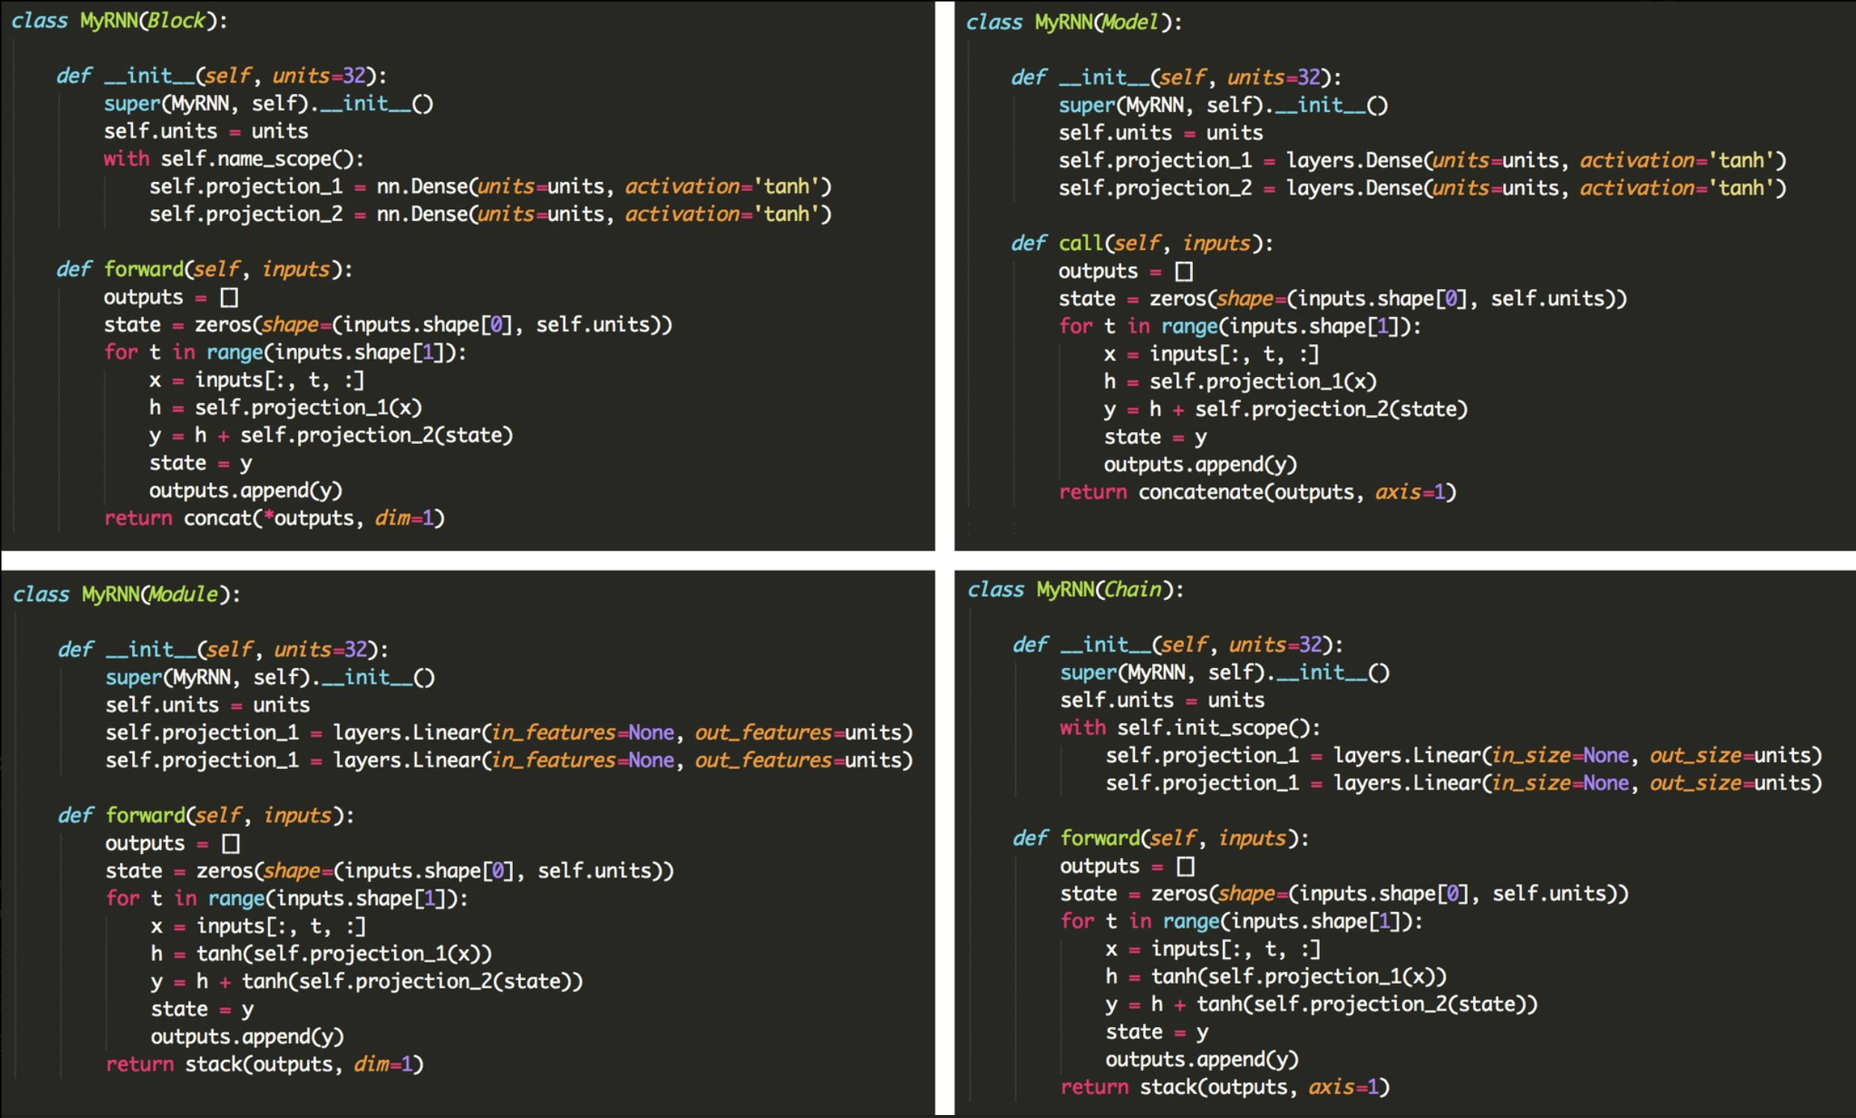

Slide 14
Let’s get started with code!

Slide 15
Q & A

Slide 16
Hackathon
https://datahack.analyticsvidhya.com/contest/pytorch-workshop-hackathon/

Slide 17
Hints
Try using a larger or a more accurate pretrained model weights (vgg16, resnet18, resnet50, inceptionv3)

Slide 18
Hints
Try using a larger or a more accurate pretrained model weights (vgg16, resnet18, resnet50, inceptionv3)
Try using more epochs

Slide 19
Hints
Try using a larger or a more accurate pretrained model weights (vgg16, resnet18, resnet50, inceptionv3)
Try using more epochs
Try freezing more layers (layers at the end)

Slide 20
Hints
Try using a larger or a more accurate pretrained model weights (vgg16, resnet18, resnet50, inceptionv3)
Try using more epochs
Try freezing more layers (layers at the end)
Try using a smaller learning rate (for larger models)

Slide 21
Hints
Try using a larger or a more accurate pretrained model weights (vgg16, resnet18, resnet50, inceptionv3)
Try using more epochs
Try freezing more layers (layers at the end)
Try using a smaller learning rate (for larger models)
Try a different optimizer (Adagrad, Adam)

Slide 22
Appendix
Newer models - https://mobile.twitter.com/quocleix/status/1064701099272093697
AdamW with superconvergence - https://www.fast.ai/2018/07/02/adam-weight-decay/
Feature Viz - https://distill.pub/2017/feature-visualization/
Convolution Arithmetic - https://docs.google.com/spreadsheets/d/1SwfVctd4TjdN2S8BL09ktpQN_41sARYzD3NEHyr-8Z0/edit#gid=0

